Slide 1


Google Earth Engine: Cloud-based Remote Sensing
James Marcaccio

Slide 2

What is GEE?
Cloud-based software
Hosts free imagery layers:
Landsat
Sentinel series
MODIS
Tools for remote sensing analyses & visualization

Slide 3


Requirements
Google account (e.g. Gmail)
Google Earth Engine account
Associated Google Cloud account for storage
Coding
Web: Javascript
Notebook: Python

Slide 4
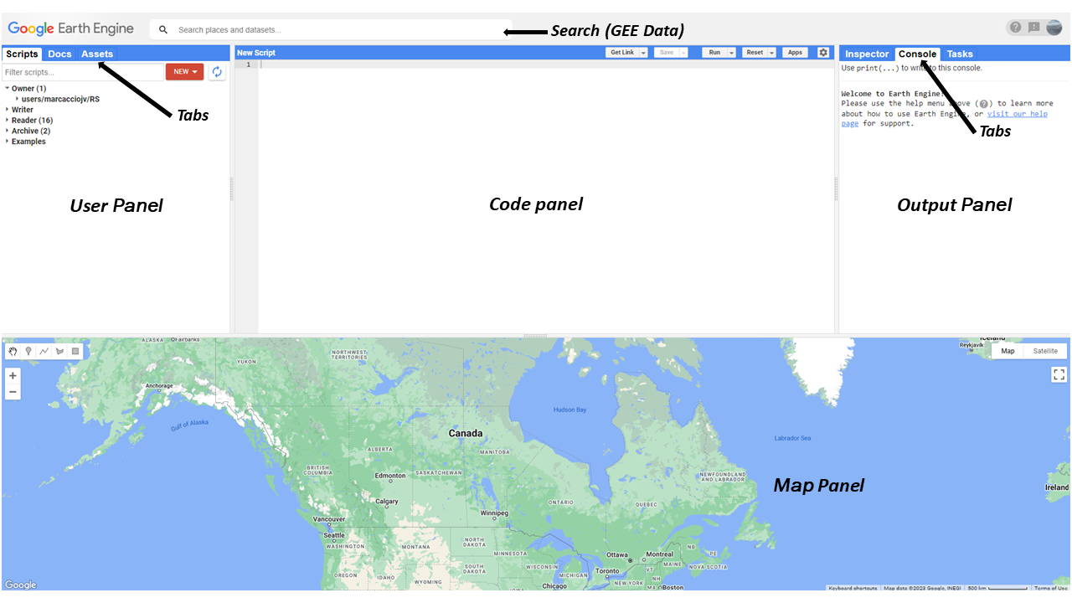

Slide 5
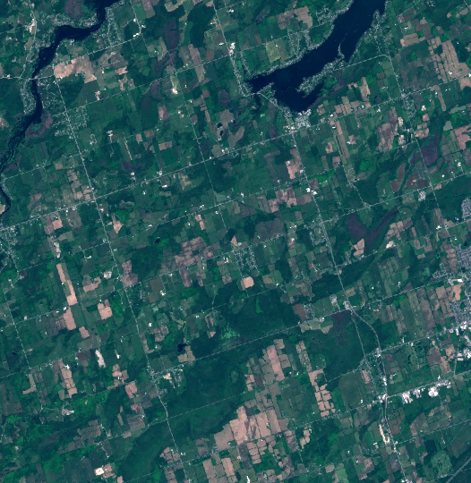
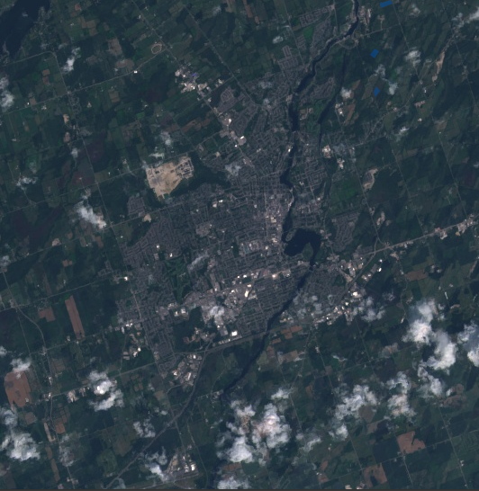
Data on GEE
Landsat (USGS): 4 through 9 (1982-ongoing)
30-m resolution, 3-11 spectral bands
Sentinel-2 (ESA): 2015-ongoing
10-m resolution, 13 spectral bands
Sentinel-2
Landsat 8

Slide 6
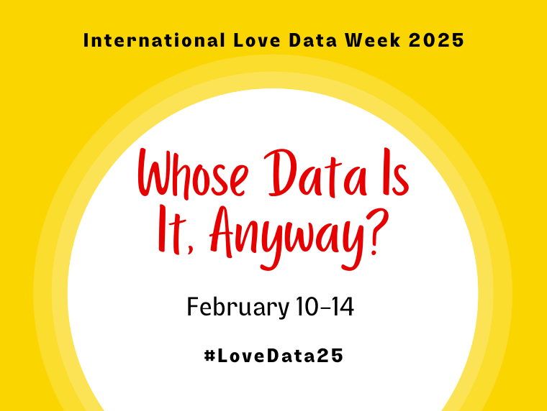
Data on GEE
MODIS (NASA): various land cover products (e.g. snow, vegetation, fire) and resolutions
Watershed boundaries
Many other satellites and features, just search!

Slide 7
User Panel: Scripts, Docs, Assets
Scripts: Code saved to your account
Docs: Reference/help to identify tools & functions
Assets: Files saved to your account (generated or uploaded)

Slide 8
Map Panel
Can zoom and pan, like Google Maps
Draw geometry (Point, Line, Polygon, Square)
Turn Layers on/off and specify symbology
Used for display purposes only

Slide 9
Output Panel: Inspector, Console, Tasks
Inspector: click tab, then click on map to show data at that location
Console: write here with print(); where errors are reported
Tasks: where data is saved to GEE or Google Drive

Slide 10
Javascript Coding in GEE
Syntax: var xxxx = yyyy.function(“specifiedText”);
String/character/text in quotations: ‘’ or “”, appear red
Numbers (not in strings) appear in blue
Imports and functions in purple
Lists are made with []
Commenting initiated with // and appear green
Multiple lines: /* and */
Imports are pinned to the top of Code Panel (above Line 1)

Slide 11



Common Data Types in GEE
Image: unsurprisingly, an image or raster file
ImageCollection: multiple images or rasters, together in one file
Image
ImageCollection

Slide 12
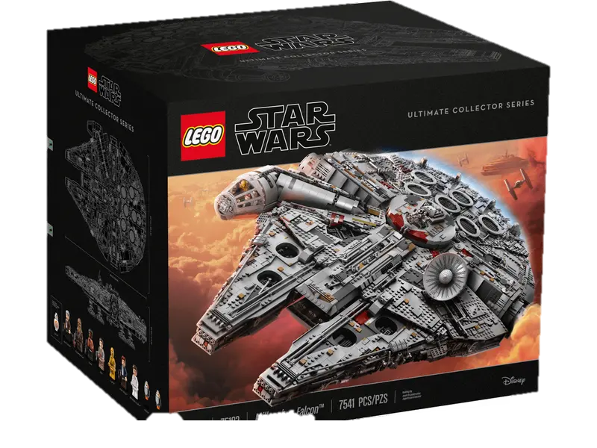
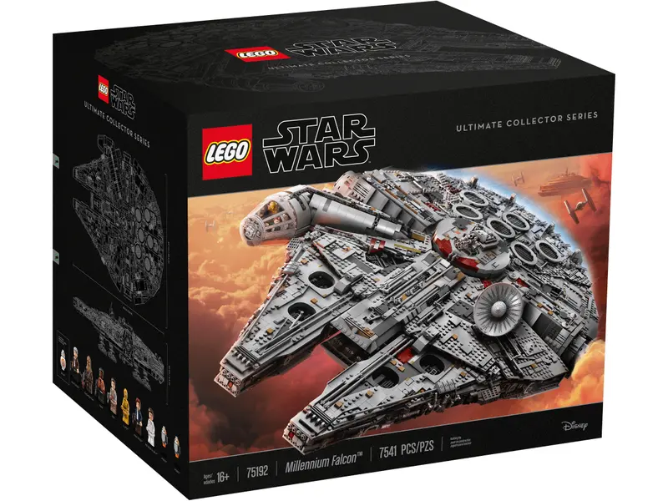


Common Data Types in GEE
Feature: a table OR vector data (i.e. polygon, line, point)
FeatureCollection: multiple tables or multiple vector data (e.g. shapefile; many polygons, lines, and/or points)
Feature
FeatureCollection

Slide 13
Common Data Types in GEE
Note: image.function() =/= imageCollection.function()
Same with Feature + FeatureCollection
Check the Docs!

Slide 14
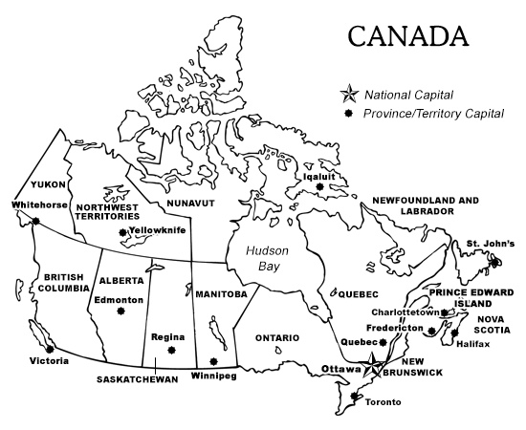
Important Functions for GEE
print():
displays the input in the console as text
Map.addLayer():
displays the input in the map panel as spatial
ImageCollection.filterBounds, .filterDate:
select only images in the ImageCollection within a geometry, date range
Specify arguments in order, or by name when wrapped in {}
Docs: Optional arguments for function are in italics

Slide 15
Links for Workshop
Github:
Code: https://code.earthengine.google.com/c0f296f0460ee08265d7103f116b5139
Data: https://trentu-my.sharepoint.com/:f:/g/personal/jamesmarcaccio_trentu_ca/EkWac6ZJA1VHtwjDZijdZv8BNgpp-O0r_XF4WGGpR0c0YQ?e=9WiBoG
Just need the zipped folder ‘GEEMaDGIC’

Slide 16
Follow Along in GEE!

Slide 17
Adding Imagery to the Map
Import the ImageCollection from Search or directly in code
Search ‘Landsat 8 TOA’ and check the page
Note Bands & band order, Image Properties
Not all satellites have the same band order!
Collection snippet: ee.ImageCollection(“LANDSAT/LC08/C02/T1_TOA”)
What happens if you perform Map.addLayer() on this? Why?

Slide 18
Filtering an Image Collection
Make a geometry in the map pane or use coordinates (list of lists)
Use filterBounds(geometry) to specify the area
Use filterDate(“”,””) to specify the time
Use filter.(ee.Filter.lt(‘CLOUD_COVER’,33)) to specify less clouds
What do we have now? Use print() to check
Functions can also be combined into one line
Image.filterBounds().filterDate().filter()

Slide 19
Displaying an Image
Map.addLayer() has five arguments
eeObject: an image or feature (only required argument)
visParams: Visualization parameters. Bands to display, colours, min and max values, etc.
Name: name of the layer as type string (appears in Map panel). Defaults to Layer X
Shown: Boolean (True/False), whether layer is displayed by default. Default is True
Opacity: layer opacity as a number between 0 and 1. Defaults to 1.

Slide 20
Displaying an Image
Display true colour imagery (Red, Green, and Blue bands together)
What are the correct band numbers for Landsat 8? Landsat 5?
Specify as a list
Minimum and maximum values change per image
Landsat TOA data usually min:0, max: 0.4

Slide 21
Fun project: ImageCollection to Video
Can create video from imageCollection stack with ui.Thumbnail()
Fun way to present data
Good to check each image in a collection

Slide 22
Manipulating Imagery: NDVI
A common image transformation is calculating NDVI
Normalized difference vegetation index
(NIR-RED)/(NIR+RED)
GEE has an in-built function, image.normalizedDifference()
Input: list of two bands
Does this function appear for an imageCollection?

Slide 23
Calculating over an imageCollection
Many functions that work on an image do not work on imageCollection
Must create a function variable and use imageCollection.map()

Slide 24
Calculating over an imageCollection
Simplest created function:
Var new = createdFunction(variable){return variable.function()}
Can use multiple steps
Output is only found in return line
Intermediate data is ‘discarded’
What data are present after this calculation?

Slide 25
Finding mean NDVI over study areas
Create geometries, ensuring they are polygons
Specify Property and Value for each study area
Or, import a shapefile and use that
Map reducer over imageCollection to get mean NDVI

Slide 26
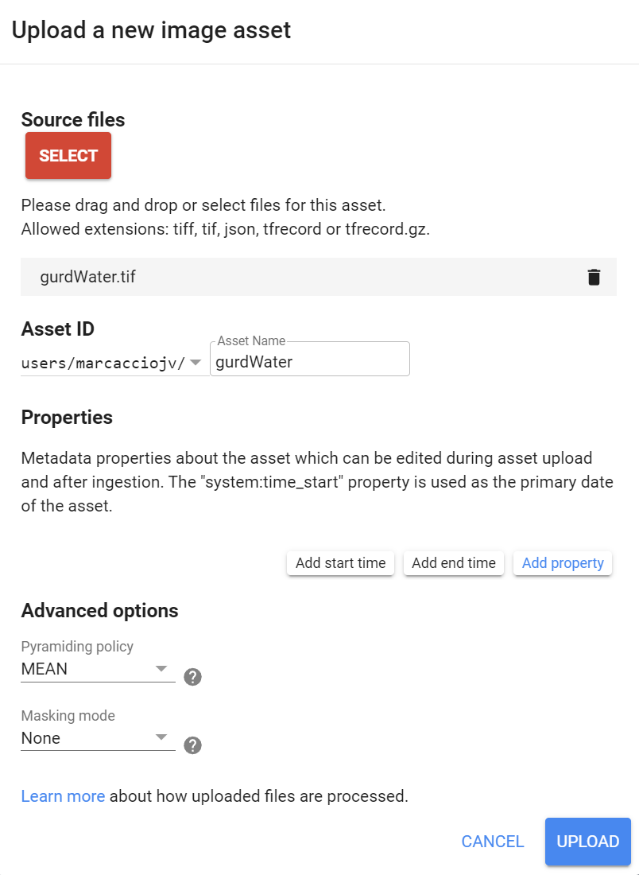
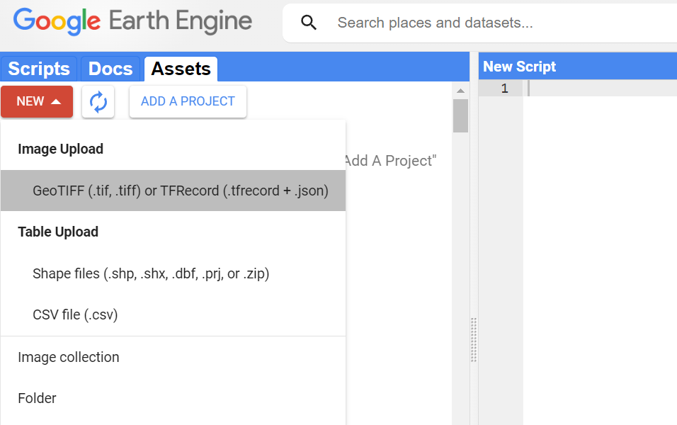
Importing Data

Slide 27
Reducing over an imageCollection
Reducers summarize inputs
Can use math (like mean, std dev) or other functions (count, first)
reduceRegions() will reduce image over a feature
Feature can be points, lines, polygons
Output: FeatureCollection
When using map() with reducers, can generate complicated arrays
Example: FeatureCollection of FeatureCollections
Use flatten() to make into a single FeatureCollection with many features

Slide 28
Exporting Data from GEE
Things we can do easily:
Exporting single image
Export features
Export video
Exporting an image collection as many images requires external tools

Slide 29
Exporting Data from GEE
Where: back to GEE (toAsset) or for download (toDrive)
Cloud Storage uses Google Cloud ($)
Folder: which folder to save the data in
Region: Spatial extent of data to be exported
Description: Task name in GEE
Not the same as ‘Filename’, but default is description=filename
Bands must have consistent type
Only export what you need

Slide 30
Exporting ImageCollections
No default way to export imageCollection at once
Use the ‘batch’ tool developed by fitoprincipe
How will we determine which image is which?
Best to copyProperties() when using map() to maintain dates
These can be used in Description/Filename

Slide 31
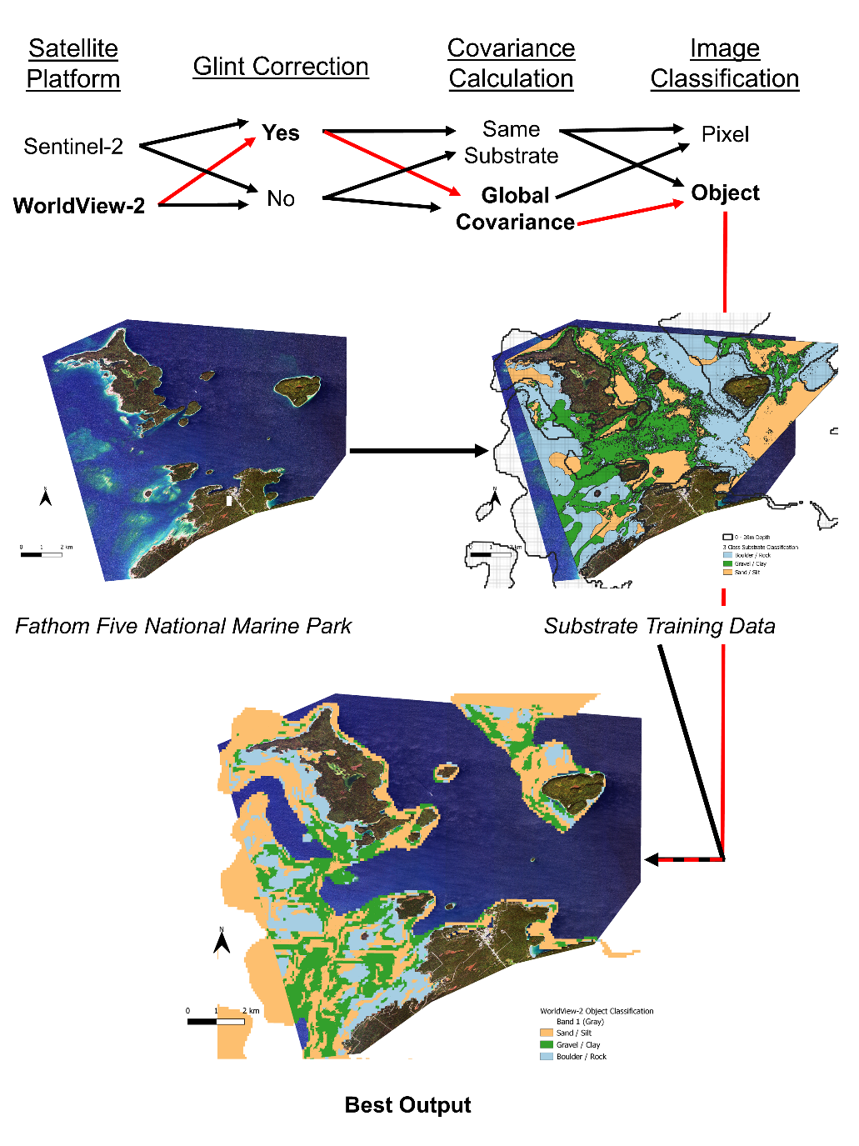
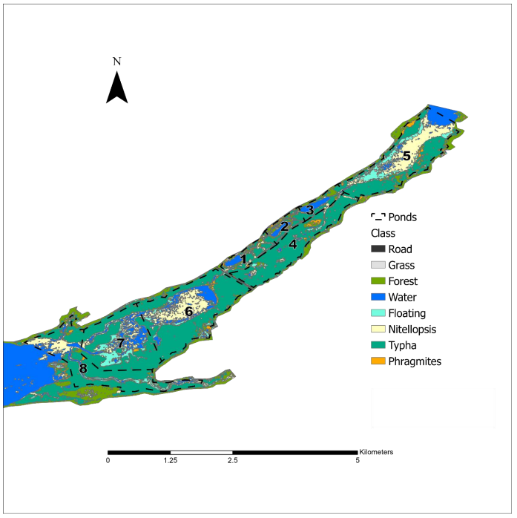
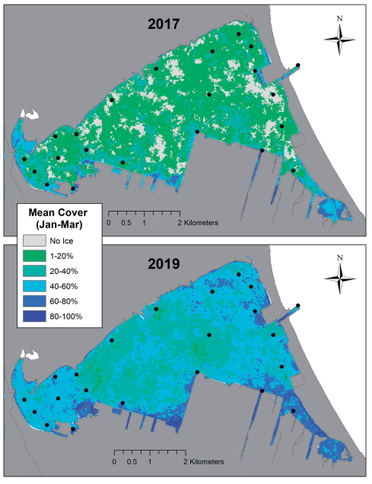
Thanks for your attention!

